Slide 1
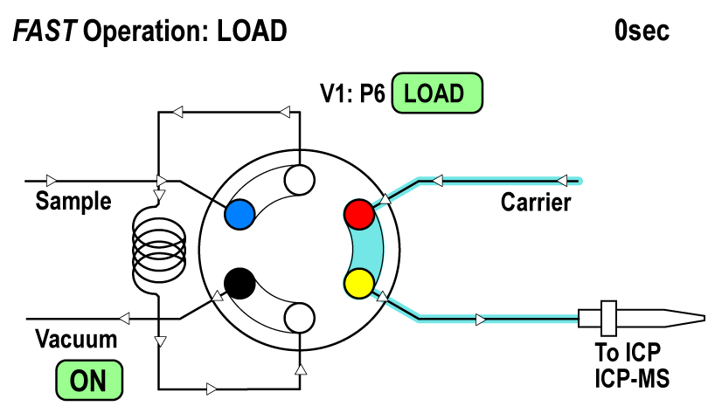
Notes:
Carrier moves through the valve while sample is drawn into the loop and valve
Load: 4 seconds

Slide 2
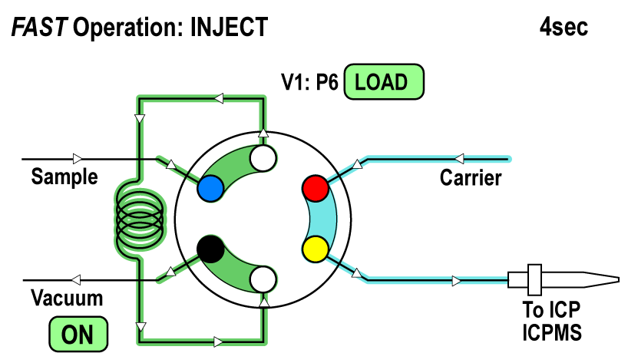
Notes:
The valve switches and carrier moves through the sample loop.
Sample is delivered to the ICP/ICPMS for analysis
Inject is the analysis time: it varies greatly from 3 seconds to 15 minutes.

Slide 3
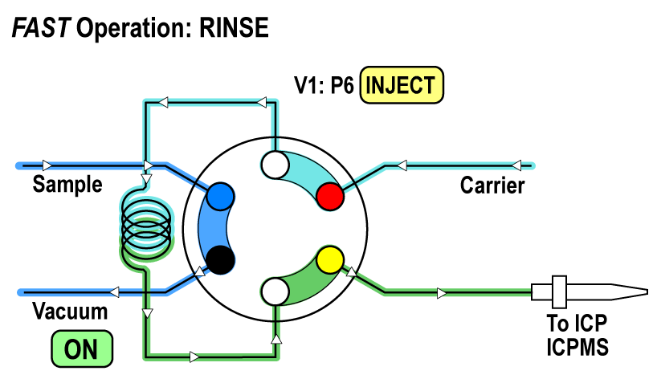
Notes:
The valve switches and rinse solution flows through the sample line. Carrier solution moves through nebulizer to the ICP/ICPMS
Usually about a 6 second rinse

Slide 4
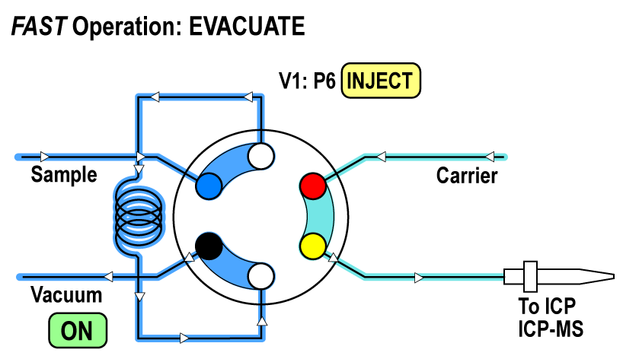
Notes:
The sample loop is prepared for the next sample by evacuating the loop of rinse solution.
1-2 seconds

