Slide 1
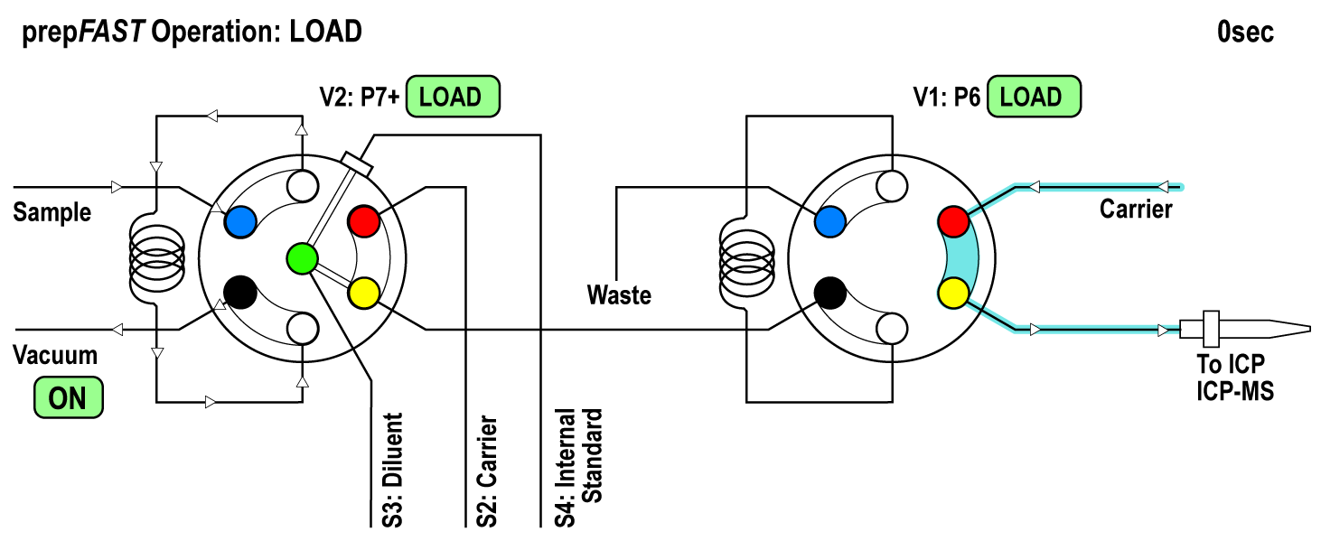
Load
Notes:
Sample is loaded into the P7+ loop in 4 seconds. Carrier runs through the P6 valve

Slide 2
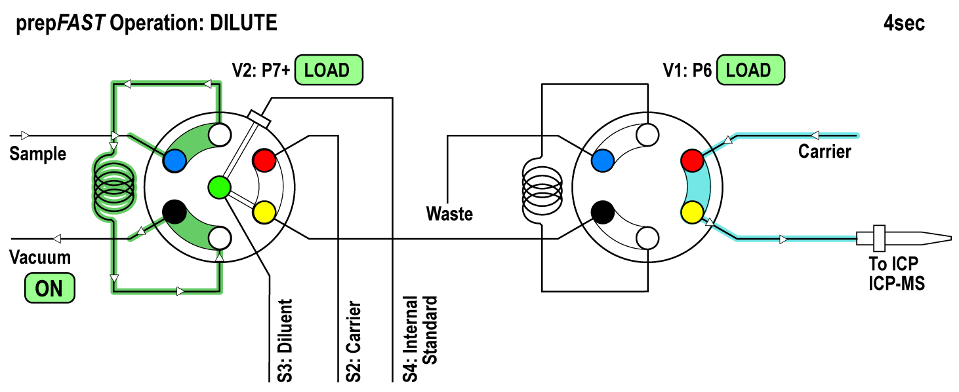
Dilute
Notes:
The valves switch and the syringes dispense for 6 seconds. The sample is mixed with the diluent and internal standard in valve. The diluted sample moves to the P6 loop (which is filled in 6 seconds).

Slide 3
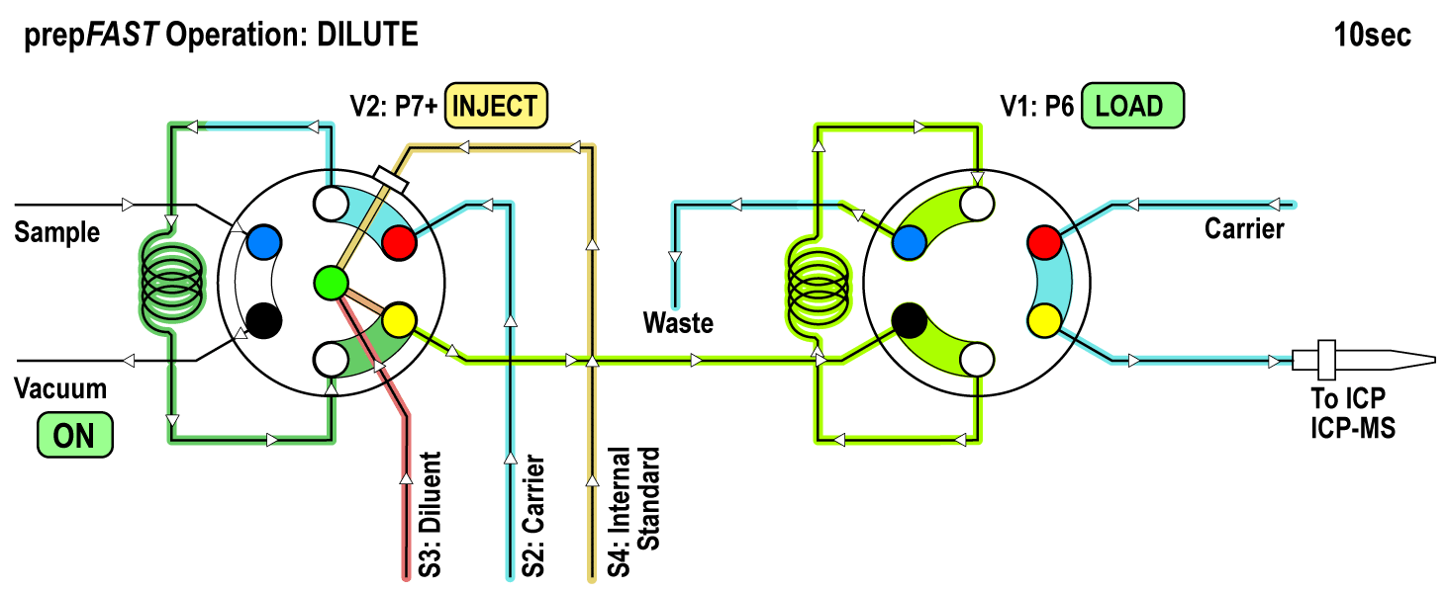
Inject
Notes:
The P6 valve switches and the sample is introduced to the ICP / ICPMS and the P7+ sample loop begins its rinse cycle. The S2 – S4 syringes refill.

Slide 4
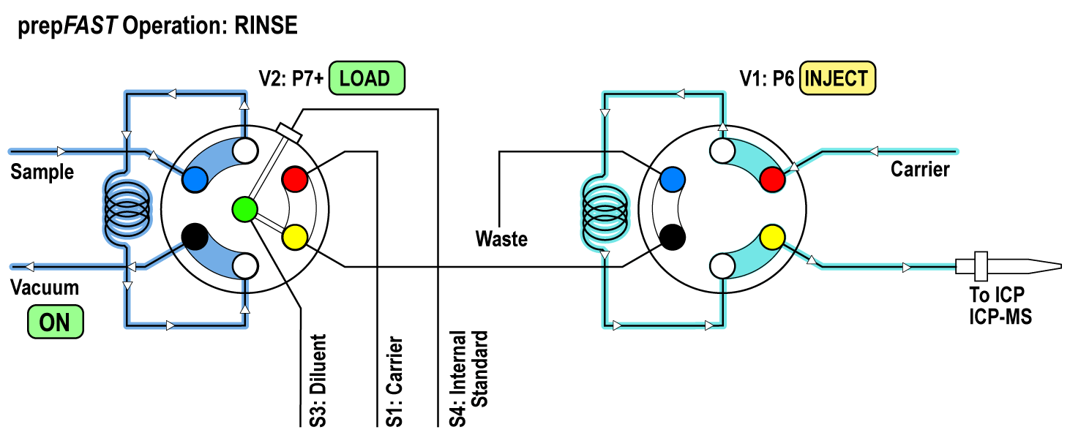
Rinse
Notes:
Rinse: 10 second rinse:
The valve on the S400V switches to rinse and the S2 carrier becomes S1 rinse. The vacuum is on and the sample and vacuum lines are evacuated: For the first 4 seconds the S1 pushes the P7+ loop into the P6 loop. After 4 seconds the P7+ valve switches it is evacuated.
S1 continues to push and cleans out the P6 loop for the remaining 6 seconds.

